Slide 1
RUNGTA COLLEGE OF DENTAL SCIENCES & RESEARCH
Oral mucous membrane
DEPARTMENT OF ORAL PATHOLOGY

Slide 2
OBJECTIVES
DEFINITION OF ORAL MUCOUS MEMBRANE
FUNCTIONS OF ORAL MUCOUS MEMBRANE
ANATOMICAL CONSIDERATION
COMPONENTS OF OM
ORAL EPITHELIUM
EPITHELIUM PROLIFERATION
EPITHELIUM MATURATION

Slide 3
Specific learning Objectives
Core areas* | Domain ** | Category #
Definition of OMM | COGNITIVE | MUST KNOW
Functions of OMM Components Of OMM Oral Epithelium Epithelium Proliferation Epithelium Maturation Age Changes of OMM Anatomical Consideration | COGNITIVE COGNITIVE COGNITIVE COGNITIVE COGNITIVE COGNITIVE | MUST KNOW MUST KNOW MUST KNOW MUST KNOW MUST KNOW NICE TO KNOW DESIRED TO KNOW

Slide 4
CONTENTS
DEFINITION OF ORAL MUCOUS MEMBRANE
FUNCTIONS OF ORAL MUCOUS MEMBRANE
ANATOMICAL CONSIDERATION
COMPONENTS OF OM
ORAL EPITHELIUM
EPITHELIUM PROLIFERATION
EPITHELIUM MATURATION

Slide 9
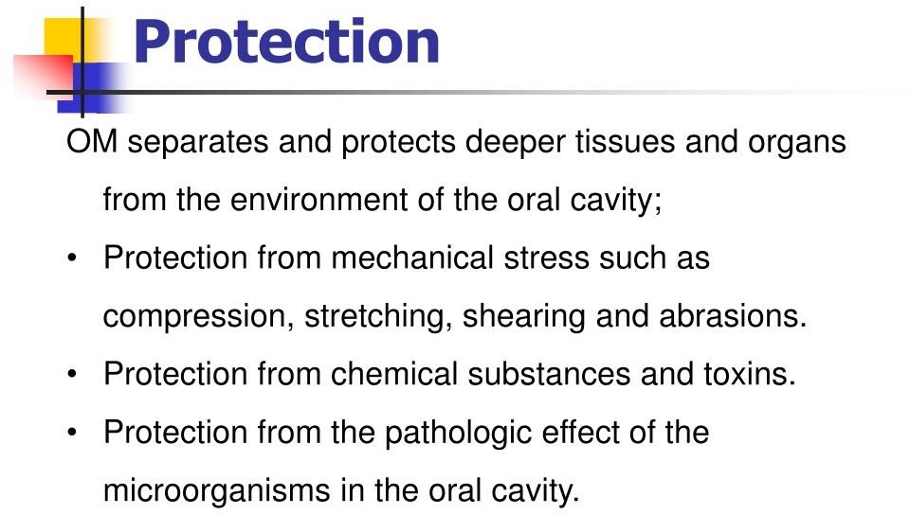

Slide 11
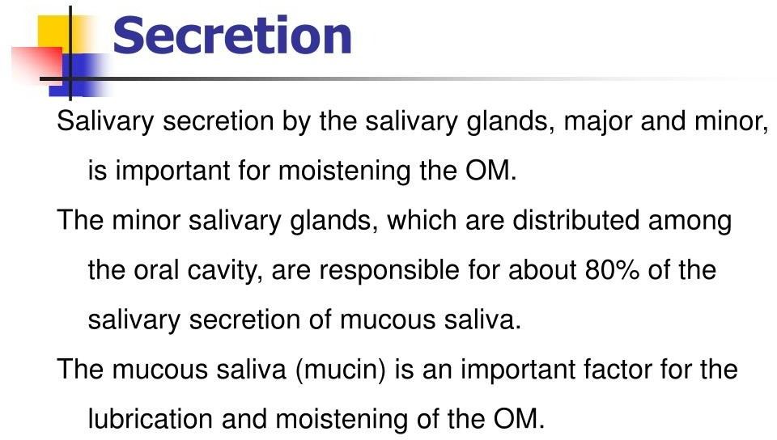

Slide 12
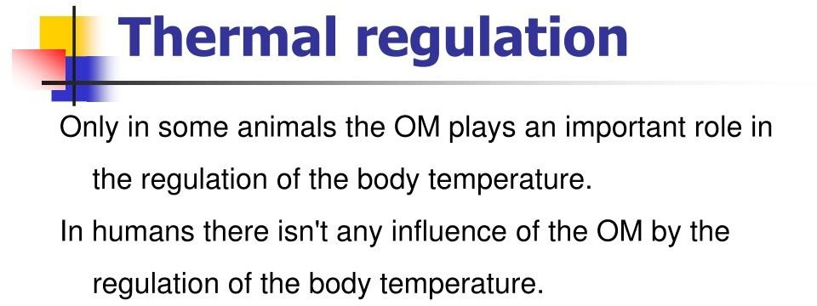

Slide 15
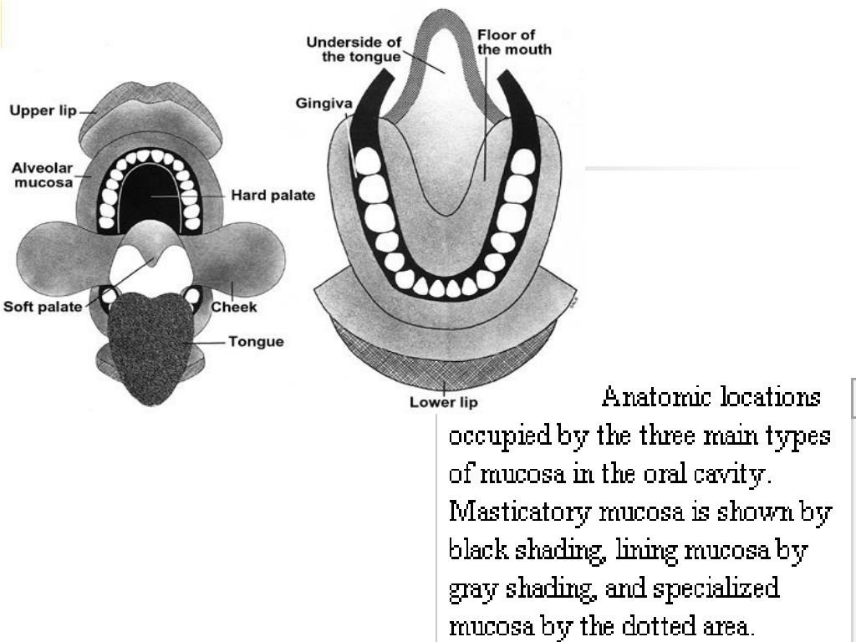

Slide 17
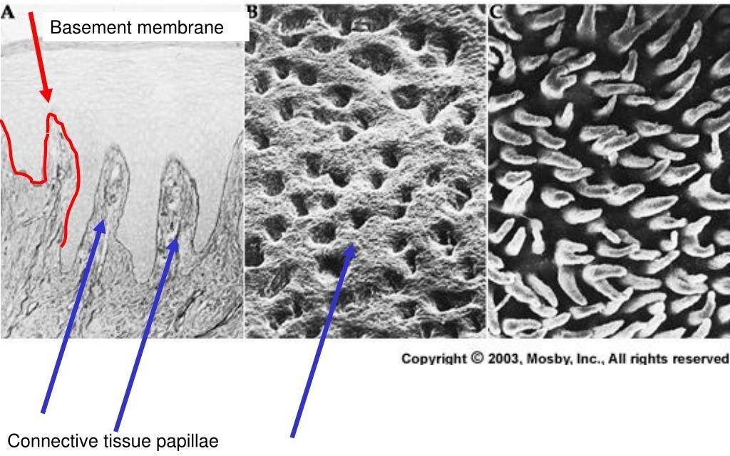

Slide 19
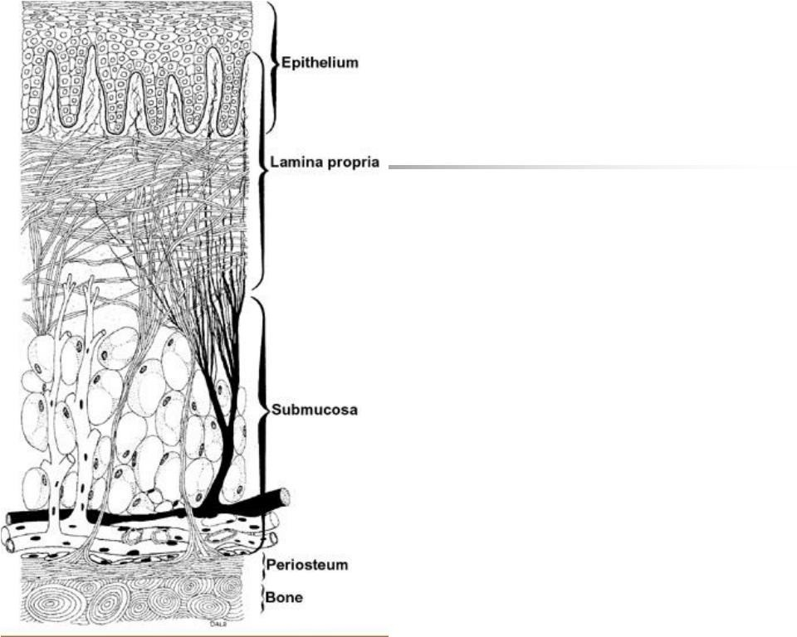

Slide 21
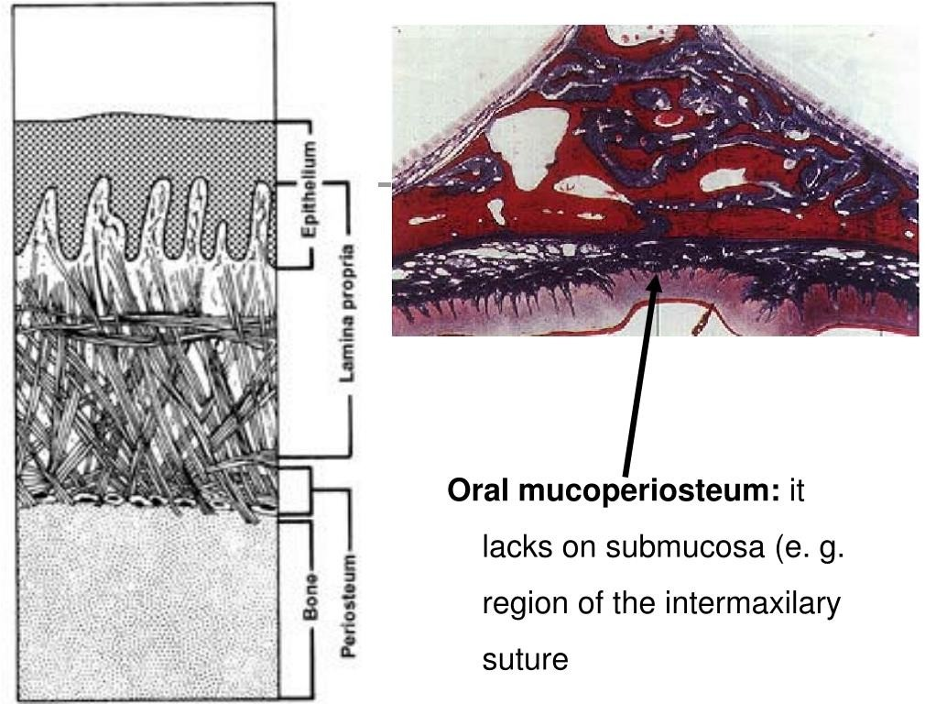

Slide 26
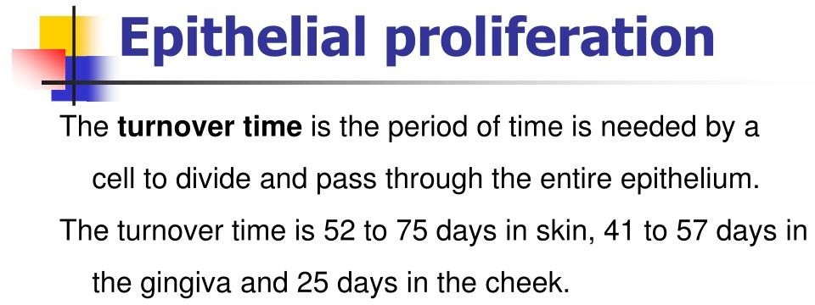

Slide 34
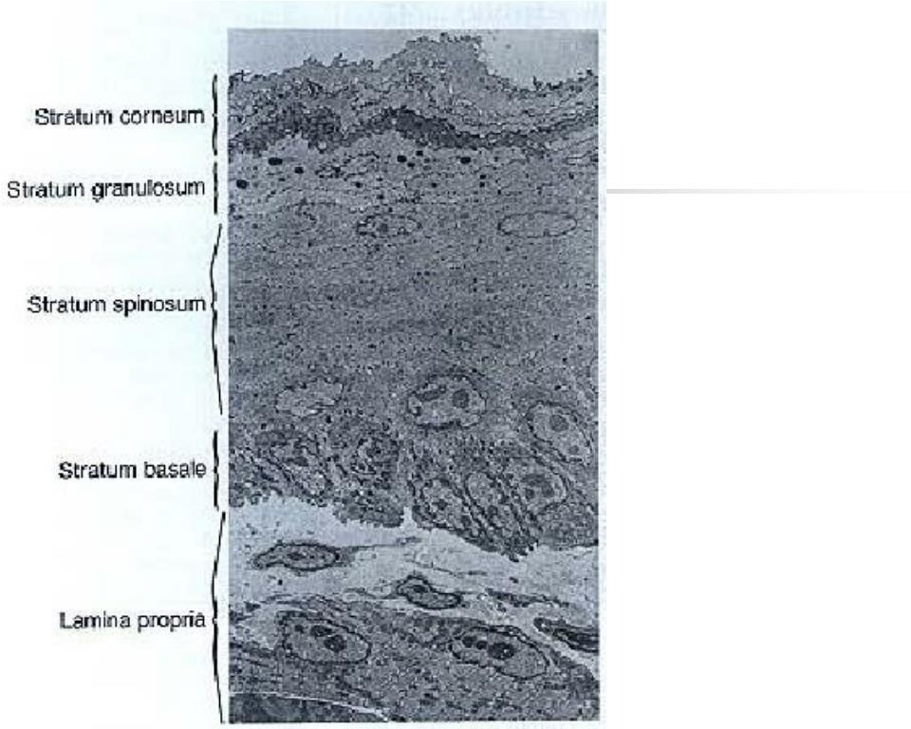

Slide 38
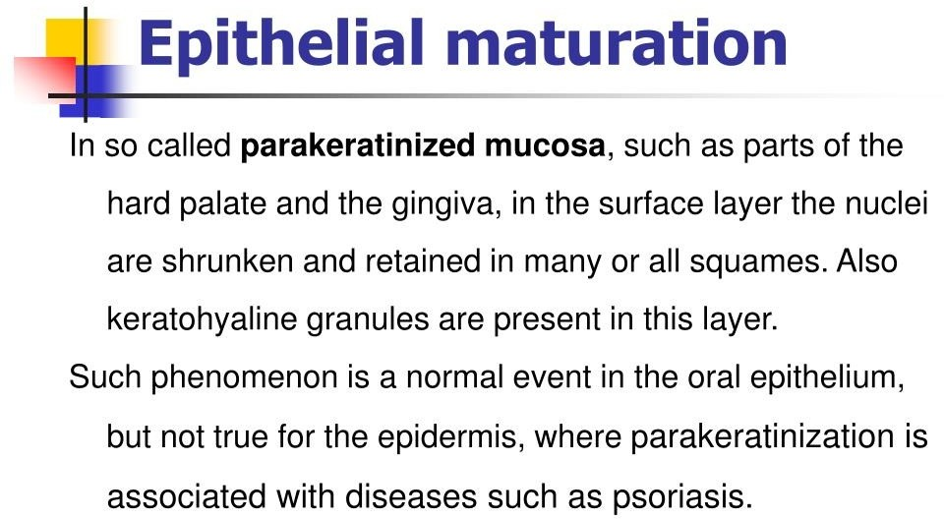

Slide 40
SUMMARY/Take home message
Oral mucous membrane maintains the integrity of the oral cavity in health and disease. Knowledge regarding the mucosa aids in detecting any changes from normalcy which would pave the way for diagnosing various disorders which affect the mucosa & thus providing treatment for the same. Also as public health dentists educating people regarding detection of changes in the mucosa.

Slide 41
References
SN Bhaskar . Orban’s ,Oral Histology and embryology. 11th edition, Mosby 1998
Neville BW ,Damm DD ,Allen CM ,Bouquot JE . Oral and maxillofacial pathology , 2nd Edition .Philadelphia W.B. Saunders ;2002
Richard Tencate , Oral Histology development ,structure and function . 5th Edition ,1998
Carranza F.A., Michael G. Newman . Clinical periodontology 8,9,10th edition

Slide 42
FAQs
Define & classify OMM. Write in detail about specialized / masticatory / lining mucosa
Difference between (or) structure of keratinized & non keratinized mucosa
Nonkeratinocytes
Parts & histology of Gingiva / hard palate
Papillaes of tongue & taste buds
Functions & age changes of OMM

Slide 43
THANK YOU

